Slide 1
Student performance prediction using machine learning
Presented by
T.Madhurima:(216F1A0585)
K.Prasanna:(226F1A05C0)
D.Shravani:(226F1A05B8)
Rahul kumar:(226F1A0564)

Slide 2


Slide 3
Machine learning
Machine learning is a branch of artificial intelligence that enables algorithms to uncover hidden patterns within datasets, allowing them to make predictions on new, similar data without explicit programming for each task. Traditional machine learning combines data with statistical tools to predict outputs, yielding actionable insights. This technology finds applications in diverse fields such as image and speech recognition, natural language processing, recommendation systems, fraud detection, portfolio optimization, and automating tasks.

Slide 4


Slide 5
Aim:students academic performance prediction
Tools:-
Programming language: Python
Libraries: scikit-learn, TensorFlow, pandas, numpy
Algorithms: Linear Regression, Decision Trees, Random Forest, Neural Networks

Slide 6
Introduction
The project aims to develop a predictive model that identifies factors influencing student academic success. By analyzing student data, the model will forecast academic performance, enabling educators to provide targeted support.

Slide 7
procedure:
1. Data collection: Gather student data (e.g., demographics, grades, attendance)
2. Data preprocessing: Clean, normalize, and feature engineer the data
3. Model selection: Choose appropriate algorithms and train models
4. Model evaluation: Assess performance using metrics (e.g., accuracy, F1-score)
5. Hyperparameter tuning: Optimize model parameters for improved performance

Slide 8
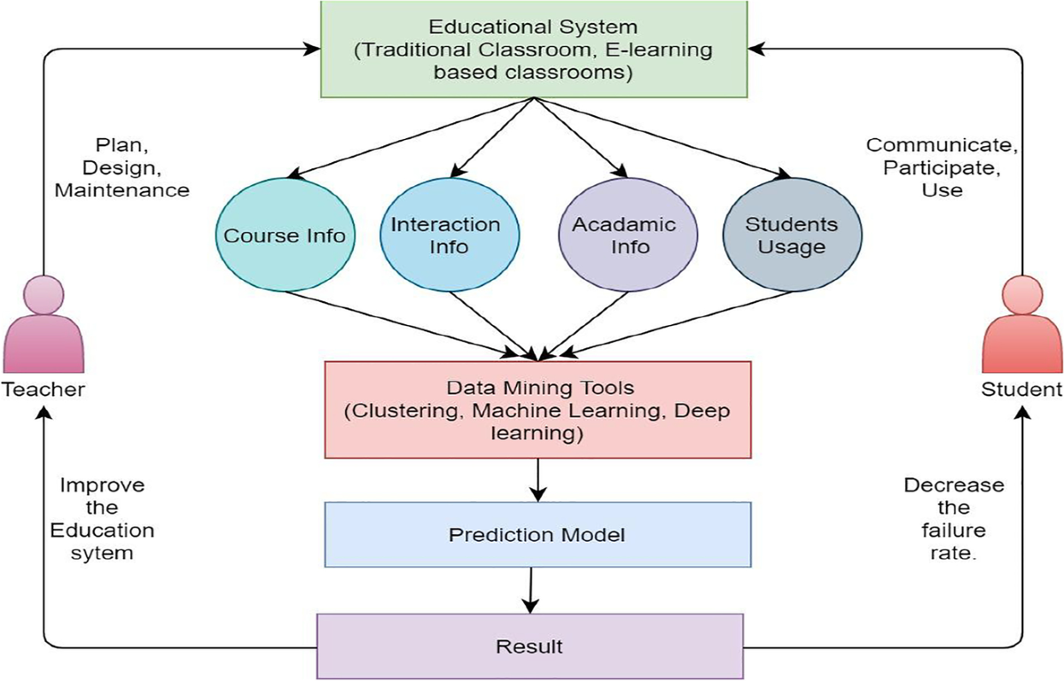

Slide 9
Features
Demographic information (age, gender, etc.)
Academic history (grades, GPA, etc.)
Attendance and engagement metrics
Extracurricular activities
Standardized test scores

Slide 10
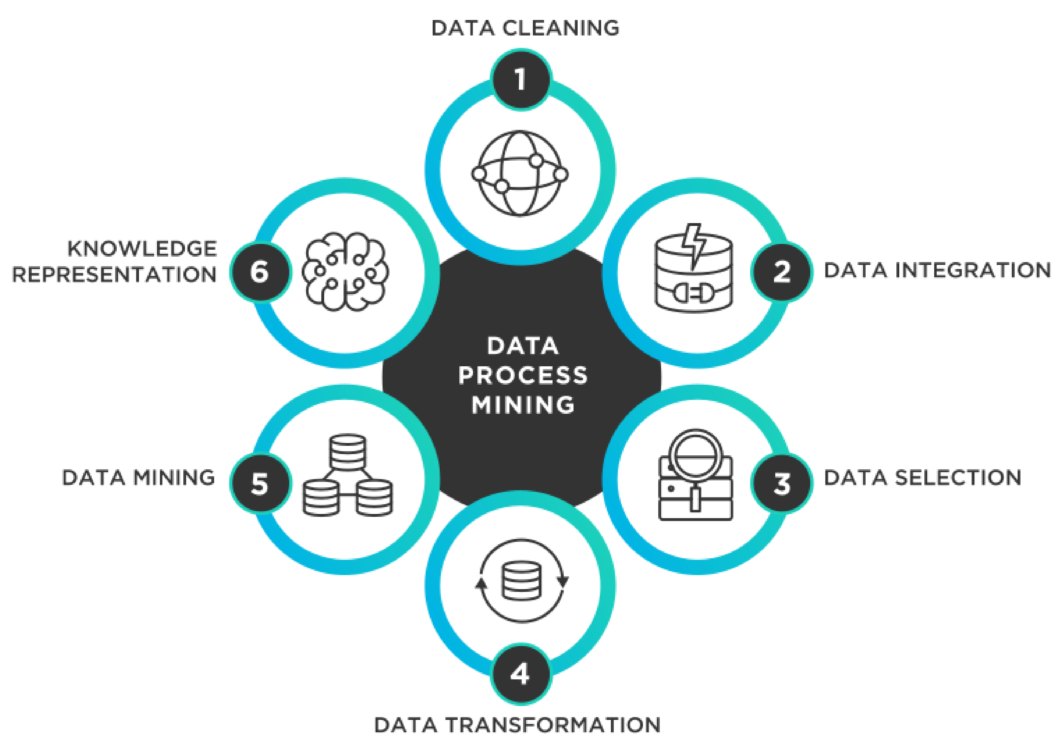

Slide 11
Students data
Name | gender | Place of birth | Section id | Roll no | Sem | relation | DS | COA | COSM | DE | JAVA | Parents college satisfaction | class

Slide 12
Source code
import pandas as pd
import seaborn as sb
import matplotlib.pyplot as plt
import time as t
import sklearn.utils as u
import sklearn.preprocessing as pp
import sklearn.tree as tr
import sklearn.ensemble as es
import sklearn.metrics as m
import sklearn.linear_model as lm
import sklearn.neural_network as nn
import numpy as np
#import random as rnd
import warnings as w
w.filterwarnings('ignore')
data = pd.read_csv("/AI-Data.csv")
ch = 0
while(ch != 10):
print("1.Marks Class Count Graph\t2.Marks Class Semester-wise Graph\n3.Marks Class Gender-wise Graph\t4.Marks Class Nationality-wise Graph\n5.Marks Class Grade-wise Graph\t6.Marks Class Section-wise Graph\n7.Marks Class Topic-wise Graph\t8.Marks Class Stage-wise Graph\n9.Marks Class Absent Days-wise\t10.No Graph\n")
ch = int(input("Enter Choice: "))
if (ch == 1):
print("Loading Graph....\n")
t.sleep(1)
print("\tMarks Class Count Graph")
axes = sb.countplot(x='Class', data=data, order=['L', 'M', 'H'])
plt.show()
elif (ch == 2):
print("Loading Graph....\n")
t.sleep(1)
print("\tMarks Class Semester-wise Graph")
fig, axesarr = plt.subplots(1, figsize=(10, 6))
sb.countplot(x='Semester', hue='Class', data=data, hue_order=['L', 'M', 'H'], axes=axesarr)
plt.show()
elif (ch == 3):
print("Loading Graph..\n")
t.sleep(1)
print("\tMarks Class Gender-wise Graph")
fig, axesarr = plt.subplots(1, figsize=(10, 6))
sb.countplot(x='gender', hue='Class', data=data, order=['M', 'F'], hue_order=['L', 'M', 'H'], axes=axesarr)
plt.show()

Slide 13
elif (ch == 4):
print("Loading Graph..\n")
t.sleep(1)
print("\tMarks Class Nationality-wise Graph")
fig, axesarr = plt.subplots(1, figsize=(10, 6))
sb.countplot(x='NationalITy', hue='Class', data=data, hue_order=['L', 'M', 'H'], axes=axesarr)
plt.show()
elif (ch == 5):
print("Loading Graph: \n")
t.sleep(1)
print("\tMarks Class Grade-wise Graph")
fig, axesarr = plt.subplots(1, figsize=(10, 6))
sb.countplot(x='GradeID', hue='Class', data=data, order=['G-02', 'G-04', 'G-05', 'G-06', 'G-07', 'G-08', 'G-09', 'G-10', 'G-11', 'G-12'], hue_order = ['L', 'M', 'H'], axes=axesarr)
plt.show()
elif (ch ==6):
print("Loading Graph..\n")
t.sleep(1)
print("\tMarks Class Section-wise Graph")
fig, axesarr = plt.subplots(1, figsize=(10, 6))
sb.countplot(x='SectionID', hue='Class', data=data, hue_order = ['L', 'M', 'H'], axes=axesarr)
plt.show()
elif (ch == 7):
print("Loading Graph..\n")
t.sleep(1)
print("\tMarks Class Topic-wise Graph")
fig, axesarr = plt.subplots(1, figsize=(10, 6))
sb.countplot(x='Topic', hue='Class', data=data, hue_order = ['L', 'M', 'H'], axes=axesarr)
plt.show()
elif (ch == 8):
print("Loading Graph..\n")
t.sleep(1)
print("\tMarks Class Stage-wise Graph")
fig, axesarr = plt.subplots(1, figsize=(10, 6))
sb.countplot(x='StageID', hue='Class', data=data, hue_order = ['L', 'M', 'H'], axes=axesarr)
plt.show()
elif (ch == 9):
print("Loading Graph..\n")
t.sleep(1)
print("\tMarks Class Absent Days-wise Graph")
fig, axesarr = plt.subplots(1, figsize=(10, 6))
sb.countplot(x='StudentAbsenceDays', hue='Class', data=data, hue_order = ['L', 'M', 'H'], axes=axesarr)
plt.show()
if(ch == 10):
print("Exiting..\n")
t.sleep(1)

Slide 14
#cor = data.corr()
#print(cor)
data = data.drop("gender", axis=1)
data = data.drop("StageID", axis=1)
data = data.drop("GradeID", axis=1)
data = data.drop("NationalITy", axis=1)
data = data.drop("PlaceofBirth", axis=1)
data = data.drop("SectionID", axis=1)
data = data.drop("Topic", axis=1)
data = data.drop("Semester", axis=1)
data = data.drop("Relation", axis=1)
data = data.drop("ParentschoolSatisfaction", axis=1)
data = data.drop("ParentAnsweringSurvey", axis=1)
#data = data.drop("VisITedResources", axis=1)
data = data.drop("AnnouncementsView", axis=1)
u.shuffle(data)
countD = 0
countP = 0
countL = 0
countR = 0
countN = 0
gradeID_dict = {"G-01" : 1,
"G-02" : 2,
"G-03" : 3,
"G-04" : 4,
"G-05" : 5,
"G-06" : 6,
"G-07" : 7,
"G-08" : 8,
"G-09" : 9,
"G-10" : 10,
"G-11" : 11,
"G-12" : 12}
data = data.replace({"GradeID" : gradeID_dict})
#sig = []
for column in data.columns:
if data[column].dtype == type(object):
le = pp.LabelEncoder()
data[column] = le.fit_transform(data[column])
ind = int(len(data) * 0.70)
feats = data.values[:, 0:4]
lbls = data.values[:,4]
feats_Train = feats[0:ind]
feats_Test = feats[(ind+1):len(feats)]
lbls_Train = lbls[0:ind]
lbls_Test = lbls[(ind+1):len(lbls)]
modelD = tr.DecisionTreeClassifier()
modelD.fit(feats_Train, lbls_Train)
lbls_predD = modelD.predict(feats_Test)
for a,b in zip(lbls_Test, lbls_predD):

Slide 15
if(a==b):
countD += 1
accD = (countD/len(lbls_Test))
print("\nAccuracy measures using Decision Tree:")
print(m.classification_report(lbls_Test, lbls_predD),"\n")
print("\nAccuracy using Decision Tree: ", str(round(accD, 3)))
t.sleep(1)
modelR = es.RandomForestClassifier()
modelR.fit(feats_Train, lbls_Train)
lbls_predR = modelR.predict(feats_Test)
for a,b in zip(lbls_Test, lbls_predR):
if(a==b):
countR += 1
print("\nAccuracy Measures for Random Forest Classifier: \n")
#print("\nConfusion Matrix: \n", m.confusion_matrix(lbls_Test, lbls_predR))
print("\n", m.classification_report(lbls_Test,lbls_predR))
accR = countR/len(lbls_Test)
print("\nAccuracy using Random Forest: ", str(round(accR, 3)))
t.sleep(1)
modelP = lm.Perceptron()
modelP.fit(feats_Train, lbls_Train)
lbls_predP = modelP.predict(feats_Test)
for a,b in zip(lbls_Test, lbls_predP):
if a == b:
countP += 1
accP = countP/len(lbls_Test)
print("\nAccuracy measures using Linear Model Perceptron:")
print(m.classification_report(lbls_Test, lbls_predP),"\n")
print("\nAccuracy using Linear Model Perceptron: ", str(round(accP, 3)), "\n")
t.sleep(1)
modelL = lm.LogisticRegression()
modelL.fit(feats_Train, lbls_Train)
lbls_predL = modelL.predict(feats_Test)
for a,b in zip(lbls_Test, lbls_predL):
if a == b:
countL += 1
accL = countL/len(lbls_Test)
print("\nAccuracy measures using Linear Model Logistic Regression:")
print(m.classification_report(lbls_Test, lbls_predL),"\n")
print("\nAccuracy using Linear Model Logistic Regression: ", str(round(accP, 3)), "\n")
t.sleep(1)

Slide 16
nat = input("Enter Nationality: ")
pob = input("Place of Birth: ")
gra = input("Grade ID as (G-<grade>): ")
if(gra == "G-02"):
gra = 2
elif (gra == "G-04"):
gra = 4
elif (gra == "G-05"):
gra = 5
elif (gra == "G-06"):
gra = 6
elif (gra == "G-07"):
gra = 7
elif (gra == "G-08"):
gra = 8
elif (gra == "G-09"):
gra = 9
elif (gra == "G-10"):
gra = 10
elif (gra == "G-11"):
gra = 11
elif (gra == "G-12"):
gra = 12
sec = input("Enter Section: ")
top = input("Enter Topic: ")
sem = input("Enter Semester (F or S): ")
if (sem.upper() == "F"):
sem = 0
elif (sem.upper() == "S"):
sem = 1
rel = input("Enter Relation (Father or Mum): ")
if (rel == "Father"):
rel = 0
elif (rel == "Mum"):
rel = 1
rai = int(input("Enter raised hands: "))
res = int(input("Enter Visited Resources: "))
ann = int(input("Enter announcements viewed: "))
dis = int(input("Enter no. of Discussions: "))
sur = input("Enter Parent Answered Survey (Y or N): ")
if (sur.upper() == "Y"):
sur = 1
elif (sur.upper() == "N"):
sur = 0
sat = input("Enter Parent School Satisfaction (Good or Bad): ")
if (sat == "Good"): sat = 1
elif (sat == "Bad"):
sat = 0
absc = input("Enter No. of Abscenes(Under-7 or Above-7): ")
if (absc == "Under-7"):
absc = 1
elif (absc == "Above-7"):
absc = 0
arr = np.array([rai, res, dis, absc])
#arr = np.array([gen, rnd.randint(0, 30), rnd.randint(0, 30), sta, gra, rnd.randint(0, 30), rnd.randint(0, 30), sem, rel, rai, res, ann, dis, sur, sat, absc])

Slide 17
predN = modelN.predict(arr.reshape(1, -1))
if (predD == 0):
predD = "H"
elif (predD == 1):
predD = "M"
elif (predD == 2):
predD = "L"
if (predR == 0):
predR = "H"
elif (predR == 1):
predR = "M"
elif (predR == 2):
predR = "L"
if (predP == 0):
predP = "H"
elif (predP == 1):
predP = "M"
elif (predP == 2):
predP = "L"
if (predL == 0):
predL = "H"
elif (predL == 1):
predL = "M"
elif (predL == 2):
predL = "L"
if (predN == 0):
predN = "H"
elif (predN == 1):
predN = "M"
elif (predN == 2):
predN = "L"
t.sleep(1)
print("\nUsing Decision Tree Classifier: ", predD)
t.sleep(1)
print("Using Random Forest Classifier: ", predR)
t.sleep(1)
print("Using Linear Model Perceptron: ", predP)
t.sleep(1)
print("Using Linear Model Logisitic Regression: ", predL)
t.sleep(1)
print("Using Neural Network MLP Classifier: ", predN)
print("\nExiting...")
t.sleep(1)
else:
print("Exiting..")
t.sleep(1)

Slide 18
Conclusion
The project developed a predictive model that accurately forecasts student academic performance. Key findings and recommendations for educators and administrators will be discussed, highlighting the potential for data-driven decision-making to enhance student success.

Slide 19


